Slide 1

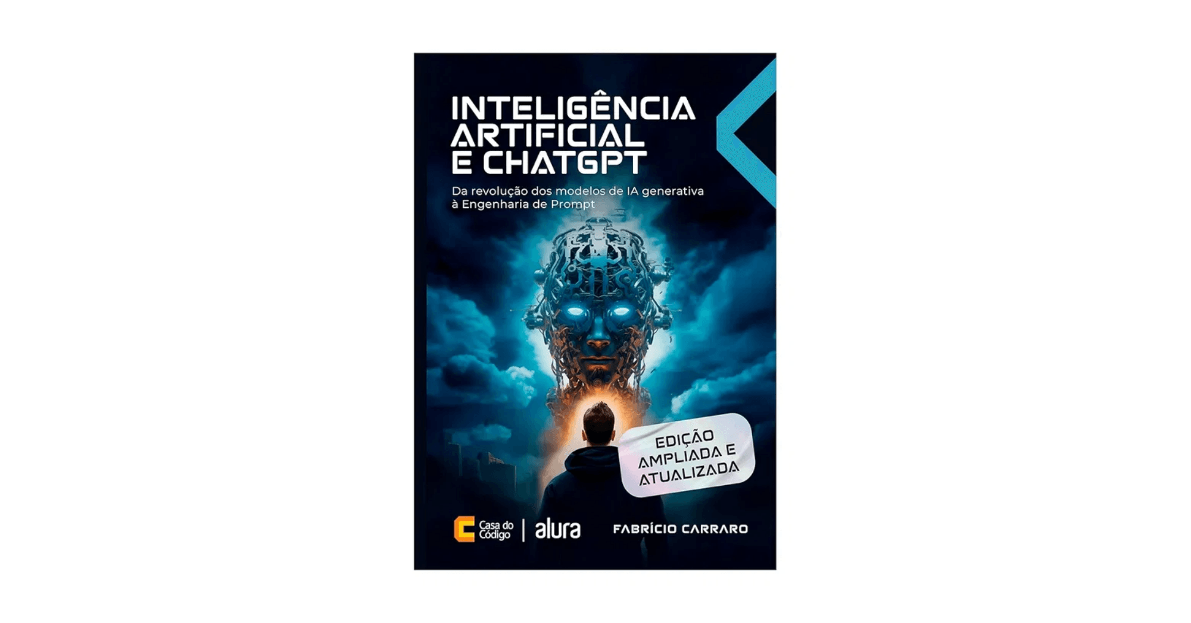
Generative Artificial Intelligence and Well Engineering
Mapping the Frontier of Capability and Quantifying Value
Vitor – PhD Candidate, Petrobras
Claudio – Postdoctoral Researcher, Petrobras
Research Collaboration Proposal with University of Stavanger (UiS)

Slide 2


Context: Petrobras and Leadership in O&G
Global Leadership in Deepwater
Petrobras is a world leader in exploration and production in highly complex environments, with consolidated expertise in offshore operations.
Critical Challenges in Well Construction
Well construction involves massive knowledge management, decision-making in safety-critical environments, and strict regulatory compliance.
Generative AI as Strategic Vector
The Cortex – Petrobras's Generative AI platform – transforms corporate data into actionable knowledge, amplifying human expertise and accelerating decision-making.

Slide 3

Project Claudio: Quantifying the Value of the Cortex Copilot
Problem
Lack of robust empirical evidence on the real benefits of AI copilots in critical industrial environments. Key questions remain unanswered: How do these systems affect productivity, decision quality, and safety?
Objective
Conduct an in vivo comparative study to quantify the benefits, mechanisms, and risks of Cortex in Well Engineering, generating field evidence to guide large-scale deployment.
Methodology
Comparative Outcomes Study comparing intensive Cortex users with control group (users from other areas). Data collection through: system usage, surveys, qualitative interviews, and process indicators.
Time Saved
Decision Quality
Safety
Information retrieval
Confidence and traceability
Access to alerts and compliance
Contribution
Provides rigorous evidence on what AI copilots deliver in production, identifying success mechanisms and guiding future implementations in O&G.

Slide 4

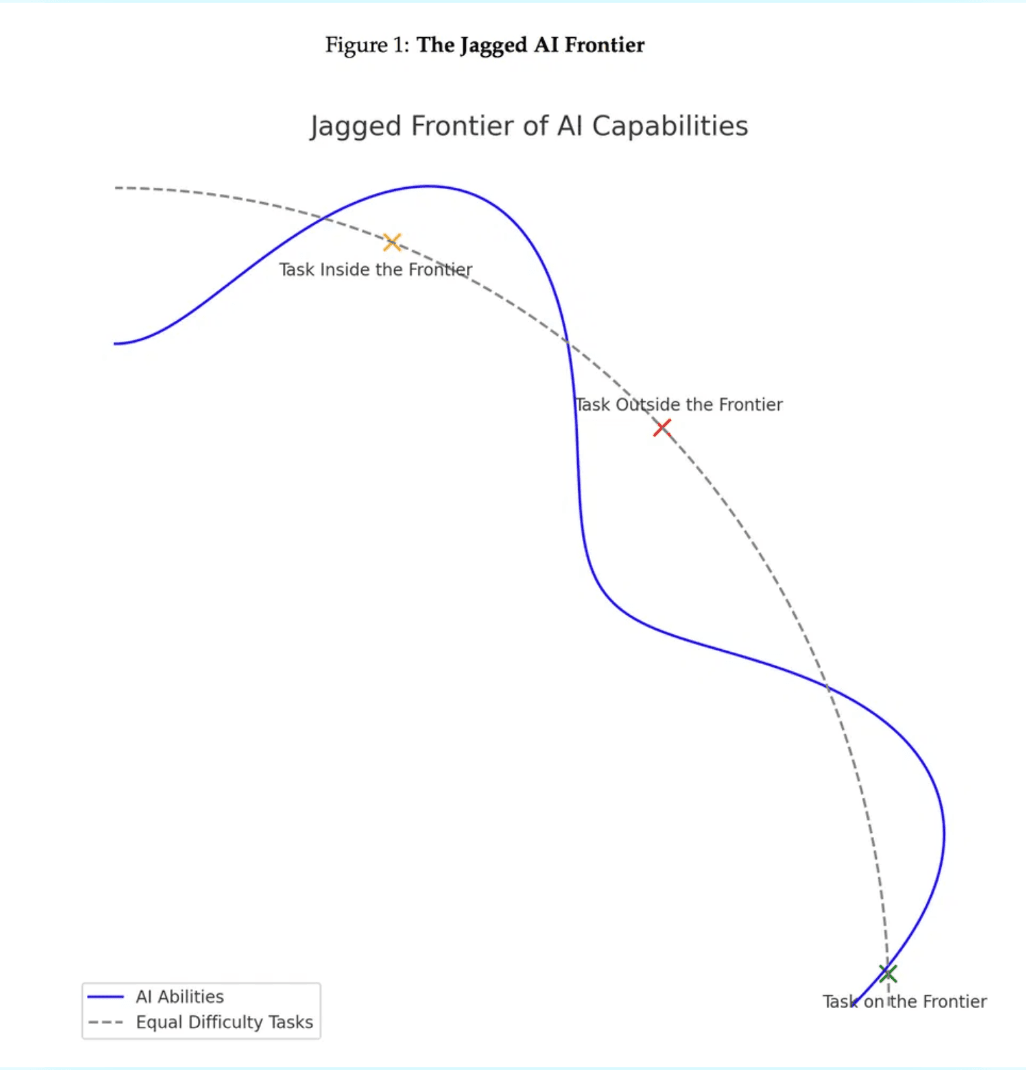
Project Vitor: Mapping the Jagged Frontier
Problem
LLM Agent performance is irregular – alternating between peaks of success and valleys of unexpected failure – in complex Well Engineering tasks. We don't know which tasks are safe for automation.
Objective
Map and characterize the Jagged Frontier of autonomous agent capability, identifying factors that determine success and failure in planning and execution tasks.
Methodology
Experimental research: (1) Taxonomy of representative tasks; (2) Experimental benchmark (sandbox) with simulated tools; (3) Systematic evaluation of different agent architectures (RAG, ReAct, etc.).
Contribution
Decision framework for safe deployment, indicating which tasks are in "peaks" (safe for automation) and which are in "valleys" (require human supervision).

Slide 5
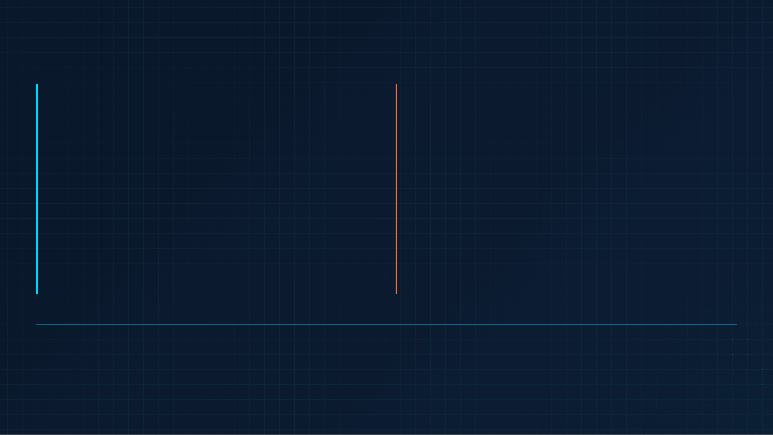
Synergy: From Copilot to Autonomous Agent
Project Claudio (Postdoc)
Project Vitor (PhD)
Focus
Focus
Value Quantification – Real benefits in production
Capability Mapping – Limits and failures
Technology
Technology
Copilot (Human Assistance)
Autonomous Agent (Automation)
Domain
Domain
Cortex (Production Platform)
Benchmark (Experimental Sandbox)
Central Question
Central Question
What does the Copilot deliver?
Where does the Agent fail?
Strategic Complementarity
Claudio validates the current value of AI (Cortex Copilot in production) and identifies success mechanisms
→
Vitor defines the future limit of AI (Safe Autonomous Agent) and failure factors, ensuring safe transition to automation
→
Both address LLM/RAG in Well Engineering with focus on safety and corporate knowledge
→

Slide 6
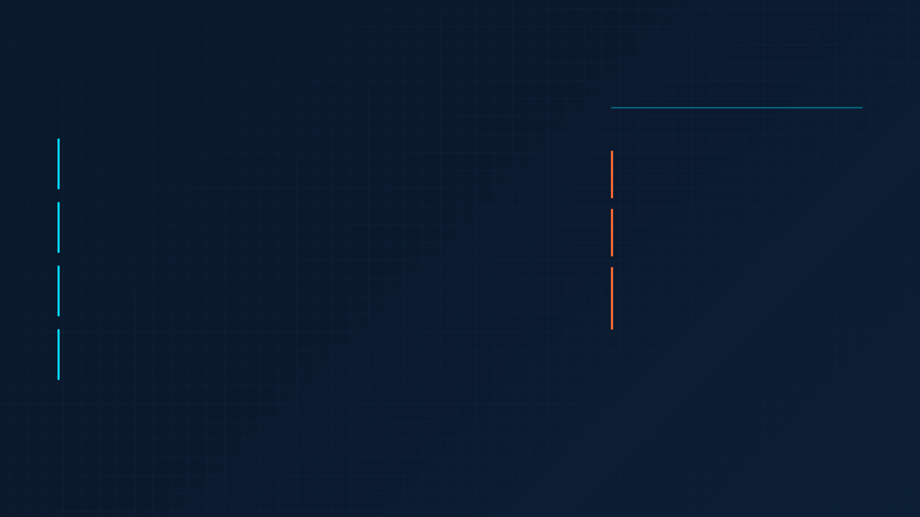
Collaboration Proposal: Leveraging UiS Expertise
How UiS Can Contribute
Mutual Benefits
1. Domain Validation
Well Engineering expertise to validate Vitor's Task Taxonomy and success criteria (Claudio/Vitor), ensuring industrial relevance.
For Petrobras:
Rigorous academic validation, access to global
O&G expertise, high-impact publications.
2. Access to Data and Case Studies
For UiS:
Possible access to Norwegian O&G data or scenarios to expand the generalization of findings beyond Petrobras context.
Access to real industrial data, opportunity for
applied AI research, visibility in O&G innovation.
3. Methodological Review
For Both:
Collaboration in defining ground truth and blind evaluation (SMEs) of Vitor's benchmark results, strengthening scientific rigor.
Advancement of knowledge in Generative AI and
Well Engineering, establishment of lasting
strategic partnership.
4. Joint Publications
High-impact articles combining industrial application (Petrobras) and cutting-edge academic research (UiS), amplifying scientific visibility.

Slide 7
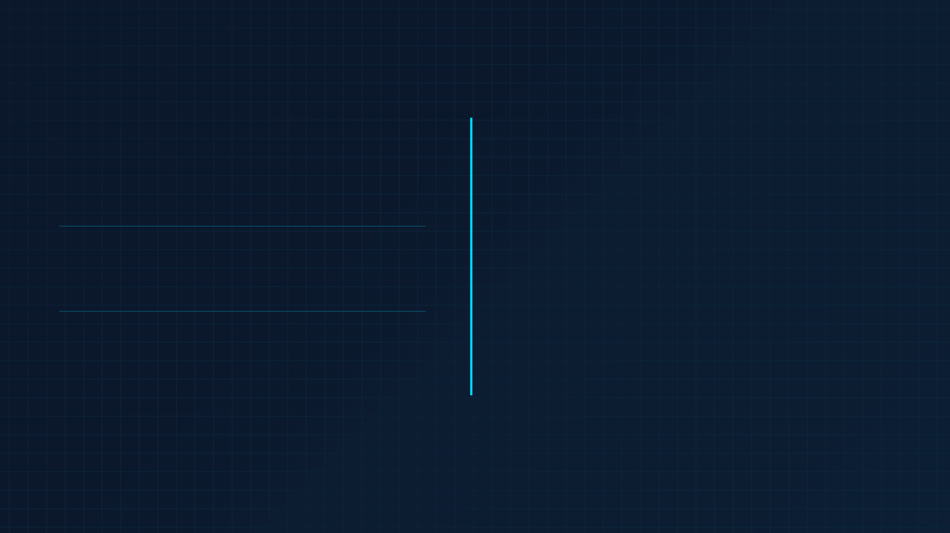
Conclusion and Next Steps
Summary of Proposal
Call to Action
1. Cutting-Edge Research
Generative AI applied to a critical and high-impact domain: Well Engineering in O&G, with focus on operational safety and efficiency.
How can we formalize a collaboration between Petrobras and UiS?
Follow-up meeting to detail the collaboration
2. Complementary Projects
→
Claudio quantifies current value (Copilot in production); Vitor maps future limits (Safe autonomous agent).
Co-supervision of researchers (UiS + Petrobras)
→
Exchange of data, methodology and expertise
→
Co-authorship in high-impact publications
3. Strategic Impact
→
Possible formal research agreement (MOU)
Results will guide safe and effective AI deployment in O&G, with immediate applicability at Petrobras and across the sector.
→

Slide 8

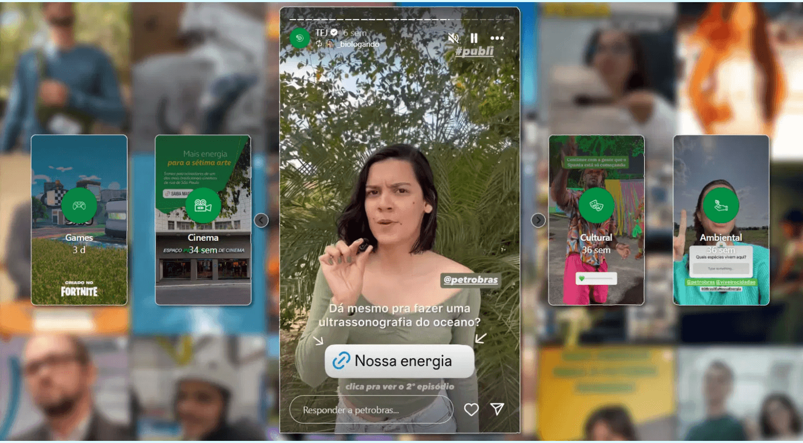
Thank You
We thank Professor Antorweep and the representatives of the University of Stavanger for their attention. We hope this presentation has demonstrated the relevance and potential for collaboration between our institutions.
Contact
Vitor
PhD Candidate, Petrobras
Claudio
Postdoctoral Researcher, Petrobras

